Slide 1
Spam Detection
Spammers be like
Jalaj Mehta - 202018033 Anjali Jain - 202018036
Darshan Jain - 202018043 Aayush Ramrakhyani - 202018046

Slide 2
Contents of this Presentation
Here’s what you’ll find in this Presentation :
Introduction
Why Spam detection?
Dataset Overview
Algorithms
Evaluation Policy
Experimental Results
Conclusion

Slide 3
Introduction
The idea of this project is to understand the step-by-step working of the spam filter and how it helps in making everyone's life easier. Also, next time when you see a “You have won a lottery” SMS rather than ignoring it, you might prefer to report it as spam. Text messaging has been one of the greatest drivers of subscriptions for mobile phones. From the simplest clamshells to modern smartphones, virtually every cellular-capable device supports SMS.

Slide 4
Why Spam Detection?
A spam filtering solution cannot be 100 percent effective. However, a business SMS system without spam filtering is highly vulnerable, if not unusable. It is important to stop as much spam as you can, to protect your Phone from the many possible risks: viruses, phishing attacks, compromised web links and other malicious content.
Spam filters also protect your Phone from being overloaded with non-essential messages.
The growth of the mobile phone users has led to a dramatic increase in SMS spam messages. Though in most parts of the world, mobile messaging channel is currently regarded as “clean” and trusted, on the contrast recent reports clearly indicate that the volume of mobile phone spam is dramatically increasing year by year

Slide 5
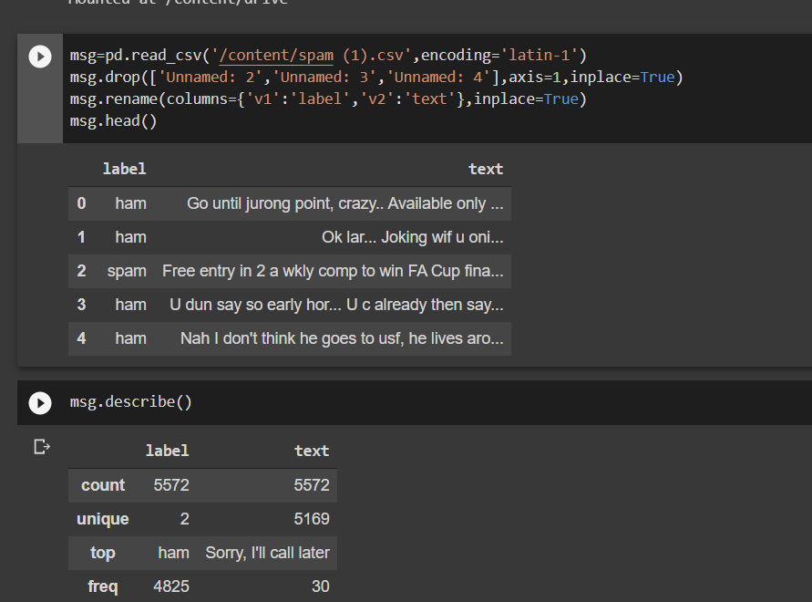
DataSet Overview
5572
5169
Rows of dataset
Unique text data
HAM
SPAM
Legitimate messages are labeled ham
Irrelevant or unsolicited messages sent

Slide 6
ALGORITHMS
Multinomial Naïve Bayes
Random Forest
Logistic Regression
It is used for integer feature counts.
It is a group learning strategy for characterization that works by developing a large number of choice trees at preparing time and yielding the class that is the method of the arrangement.
It is a factual model that in its fundamental structure utilizes a calculated capacity to show a double needy variable and we have used it to model the probability of an SMS as spam or not

Slide 7
Evaluation Policy
Assessing order models A characterization model spots models into one of at least two classifications. For estimating classifier execution, we'll initially present the inconceivably helpful device called the disarray lattice and show how it very well may be utilized to compute numerous significant assessment scores. The principal score we'll examine is exactness.
The principal score we examine are as follow:
1)Accuracy
2)Precision
3)Recall
4)F1 Score

Slide 8

1) Accuracy
Accuracy is one metric for evaluating classification models. Informally, accuracy is the fraction of predictions our model got right.

Slide 9

2) Precision
The precision for a class is the number of true positives divided by the total number of elements labeled as belonging to the positive class.

Slide 10

3) Recall
Recall indicates what percentage of the classes we’re interested in was actually captured by the model

Slide 11

4) F1 Score
F1 score combines precision and recalls relative to a specific positive class -The F1 score can be interpreted as a weighted average of the precision and recall, where an F1 score reaches its best value at 1 and worst at 0.

Slide 12
Experimental Results
Multinomial Naive Bayes
Random Forest
Logistic Regression
We have found the accuracy of our model by using a confusion matrix and we got different accuracies for different classification such as:
ACCURACY
ACCURACY
ACCURACY
$7,99
0.9758
0.9246
0.9816
$14,99
$14,99

Slide 13
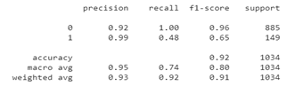
Experimental Results
We have also found the precision, recall, f1-score, and support of different classifiers for our spam model and compared the results. Below are the respective results of three classifiers:
Multinomial Naive Bayes
Earth
Earth is the third planet from the Sun

Slide 14
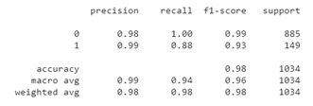
Experimental Results
We have also found the precision, recall, f1-score, and support of different classifiers for our spam model and compared the results. Below are the respective results of three classifiers:
Random Forest
Earth
Earth is the third planet from the Sun

Slide 15
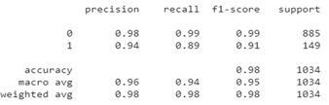
Experimental Results
We have also found the precision, recall, f1-score, and support of different classifiers for our spam model and compared the results. Below are the respective results of three classifiers:
Logistic Regression
Earth
Earth is the third planet from the Sun

Slide 16
Conclusion
Spam Detection is significant for getting messages and email correspondence. The precise recognition of spam is a major issue and numerous discovery techniques have been proposed by different analysts. Be that as it may, these techniques have an absence of ability to recognize spam precisely and proficiently. The SMS Spam issue is expanding these days with the expansion in the utilization of text informing. Thus, we attempted to take care of this issue by making SMS Spam Detection. The fundamental point of this paper is to contrast diverse AI models with foreseeing whether the message in the dataset is Ham or Spam and predicts the exhibition through precision rule. Utilizing these Models, we can see if the information in the dataset is unsurprising. In this paper, we have made a SMS Spam Detection Model in which we have carried out three order methods dependent on AI calculations to be specific Multinomial Naïve Bayes, Logistic Regression, and Random Forest. Further, we have checked the exactness, accuracy, recall,f1-score, and backing of each of the three classifiers.

Slide 17
REFERENCES
Bosaeed, Sahar, Iyad Katib, and Rashid Mehmood. "A Fog-Augmented Machine Learning based SMS Spam Detection and Classification System." In 2020 Fifth International Conference on Fog and Mobile Edge Computing (FMEC), pp. 325-330. IEEE, 2020.
Navaney, Pavas, Gaurav Dubey, and Ajay Rana. "SMS spam filtering using supervised machine learning algorithms." In 2018 8th International Conference on Cloud Computing, Data Science & Engineering (Confluence), pp. 43-48. IEEE, 2018.
Shirani-Mehr, Houshmand. "SMS spam detection using machine learning approach." unpublished) http://cs229. stanford. edu/proj2013/Shir aniMeh r-SMSSpamDetectionUsing Machine Learning Approach. pdf (2013).GitHub reeves-wisec 16.pdf (ufl.edu)
Various ways to evaluate a machine learning model’s performance | by Kartik Nighania | Towards Data Science
Types of Classification Tasks in Machine Learning (machinelearningmastery.com)
https://pythonprogramminglanguage.com/logistic-r egression-spam-filter/

Slide 18


